Slide 1
Virtusa Quality Management Framework

Slide 2
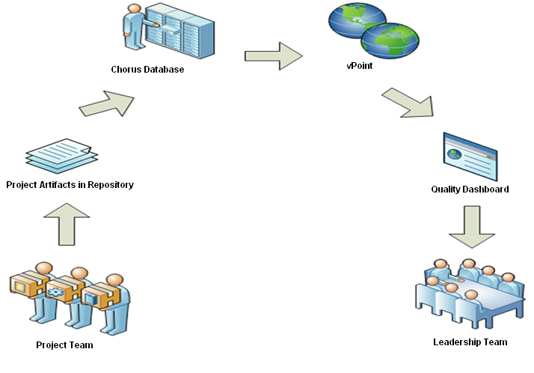
Bird’s Eye View of the current Framework

Slide 3
Objective
Main objective of VQMF is to measure quality of software product throughout its lifecycle
Product take many shapes and forms across SDLC
Document form - Requirements document, Architecture and design document, Code, etc
Functional Product form - Units and modules, Integrated Software & Deployed fully functional product
Quality of the product is measured through verifications (reviews) when it is in document form and validations (testing) when it is in functional product form

Slide 4
Metrics for the entire Life Cycle
QC Activity – Requirements review
Architecture and Design Phase
QC Activity – Design review
Coding Phase
QC Activity – Unit and Integration Testing
QA Testing Phase
Deployment Phase
QC Activity – QA Testing
Unit & Integration Phase
QC Activity – Code review
Measurements – review coverage, number of review comment and severity
Metrics – review coverage, review comments density and severity index
Measurements – review Coverage, number of review comment and severity
Metrics – review coverage, review comments density and severity index
Metrics – Test coverage, defects density and severity index
Measurements – Test Coverage, number of defects and severity
Measurements – Test Coverage, number of defects and severity
Metrics – Test coverage, defects density and severity index
Measurements – review coverage, number of review comment and severity
Metrics – review coverage, review comments density and severity index
QC Activity – User Acceptance Testing
Measurements – Test Coverage, number of defects and severity
Metrics – Test coverage, defects density and severity index
Requirements Phase
Test Strategy & Planning
Test Design
Test Case Development
Test Automation
Test Execution and Reporting

Slide 5
Calculating Metrics
Metric Calculations could be seen as the heart of the entire framework because such calculated metrics will be
Displayed in the Quality Dashboard of VPoint
Used to evaluate project performance by leadership team
Used as input to the decision making process
Accuracy of data taken for the calculations is important
Gathering required data for the calculations should not be time consuming or exhausting the project resources

Slide 6
VQMF Tool
VQMF Tool is a software application which automates the process of
analyzing artifacts to obtain required information for metrics,
computing parameters used to develop quality metrics and
Submitting to chorus through e-forms
At present, VQMF tool facilitates submission of
Weekly test coverage summary e-form
Client reported external defect summary e-form
Virtusa reported external defect summary e-form

Slide 7
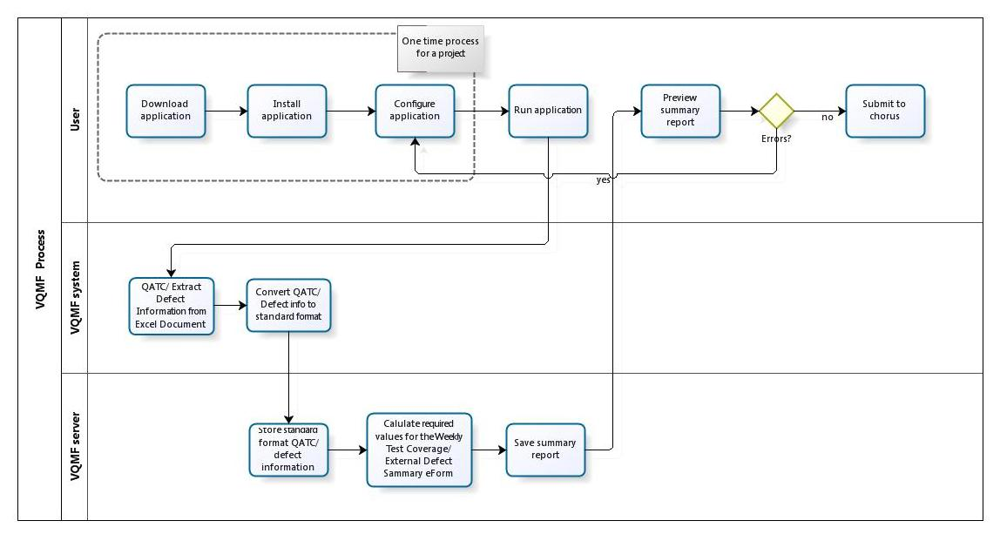
How VQMF tool works..

Slide 8
How to use VQMF tool?
Below is the high level flow of how to use the VQMF tool to submit eForms to chorus
1.Download VQMF tool
2.Install
3.Configure
5.Viewing and Submitting summary data to Chorus
6. vPoint - Dashboard
4.Run

Slide 9
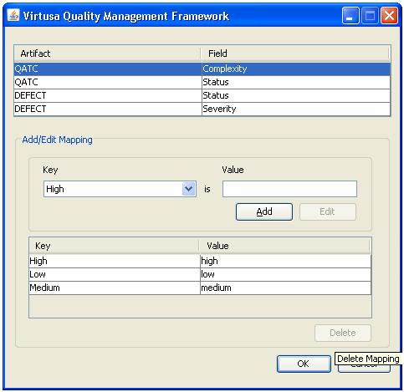
How to use VQMF tool? – Field value mapping
Field Mapping for QATC & Defect documents
To map the fields values of the QATC or Defect sheet user can use the fields mapping window.

Slide 10
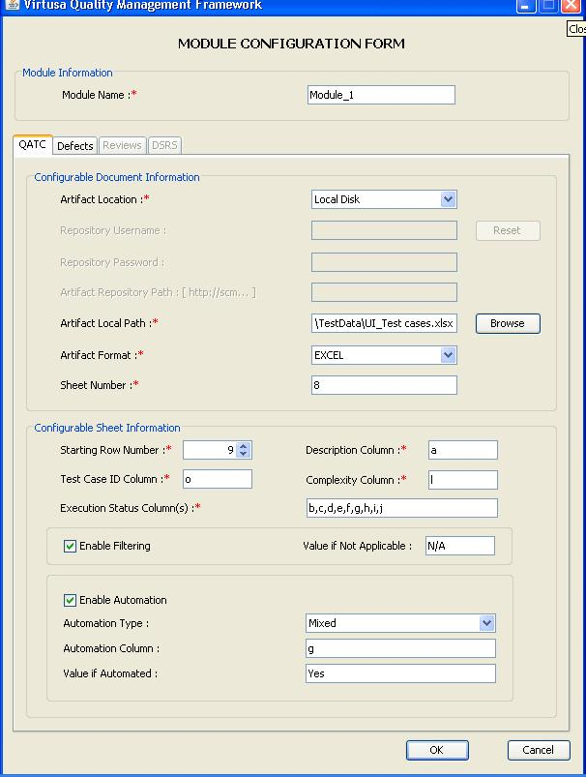
How to use VQMF tool? – Configure QATC
Module configuration for QATC

Slide 11
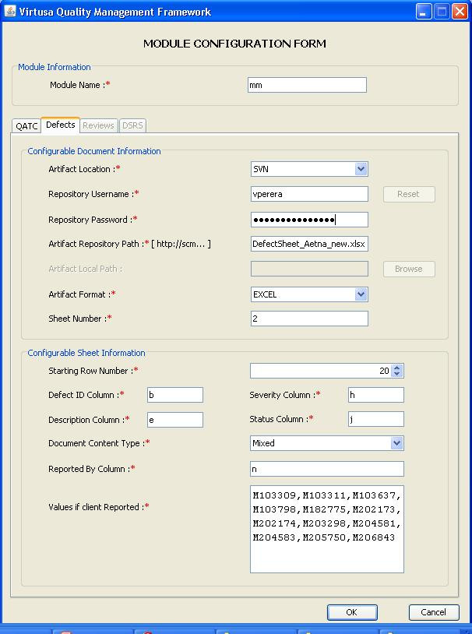
How to use VQMF tool? – Configure Defects
Module configuration for Defect

Slide 12
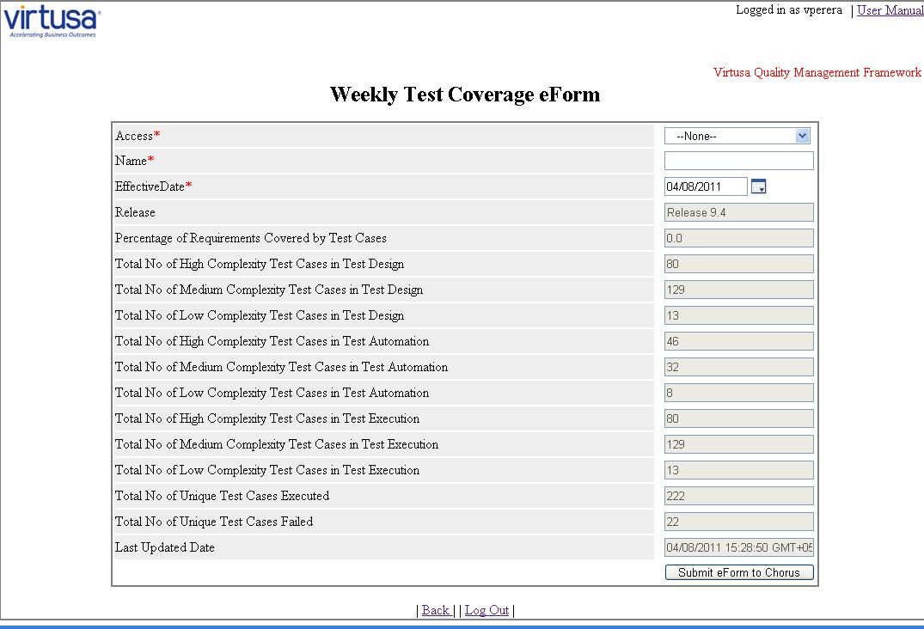
How to use VQMF tool? – Submitting to Chorus
How to View and Submit the eForms to Chorus
Login to the VQMF server (http://ct-vqmfsvr:8080/vqmf-server/) using Chorus credentials
After a successful login, to view the summary of the executed project, select the Project and Release. Then select the eForm and click on “Next” button

Slide 13
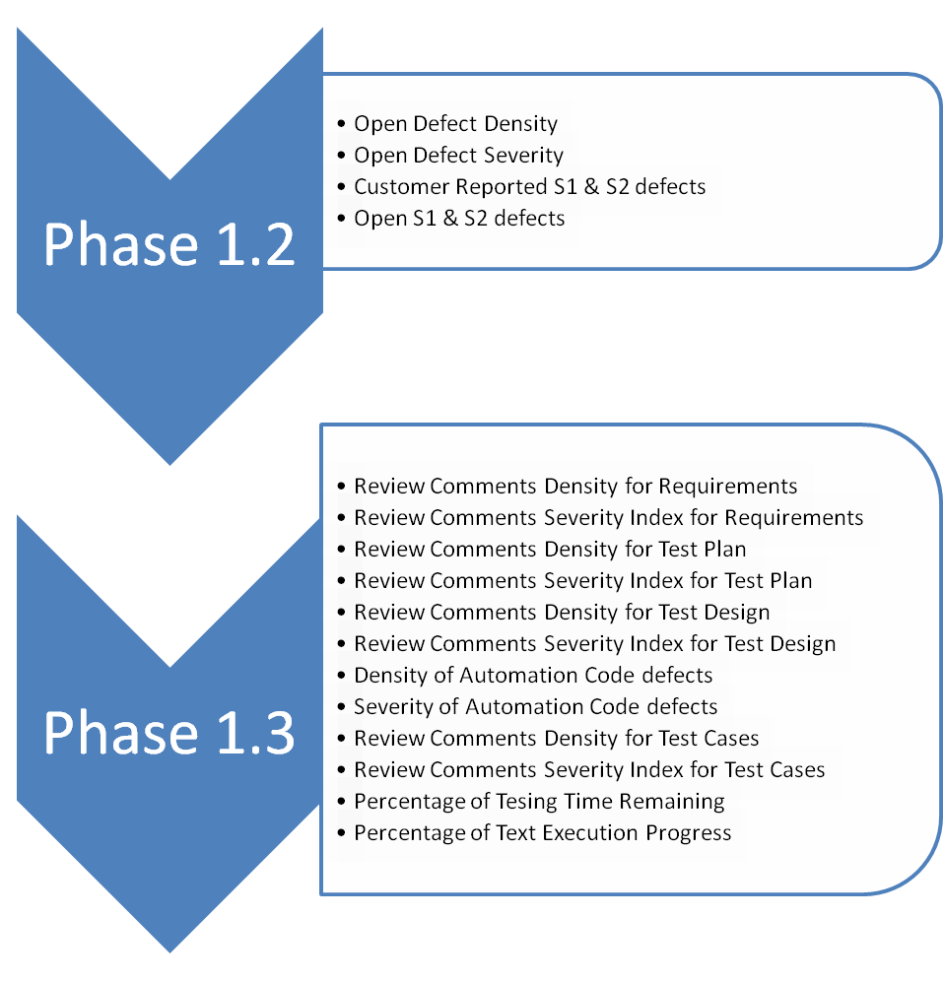
Next Releases of VQMF…

Slide 14
Future of VQMF
Vision is to enhance VQMF for …….
analyzing the Quality throughout SDLC using sequence of metrics
providing accurate and in-detail view of the software quality
allowing the management to make fully informative decisions
Features in the road map
VQMF tool to be an independent product
Have own Dashboard and capability of plug-in to different Dashboards
To have complete set of Quality Metrics
Support different artifact Templates through tool customization
Trends analysis
Benchmarking/ Comparison of software quality

Slide 15
VQMF
Q & A

